Slide 1
Лабораторное обеспечение
Hardware Tools
Evaluations Boards (Оценочные модули) STM32F407-DISCOVERY STM32F401 NUCLEO
STM32F417-DISCOVERY
Expansion boards shields (платы расширения)
Software Tools
Documentations

Slide 2
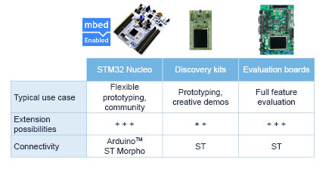
STM32 MCU Eval Boards (Оценочные модули)
STM32 Nucleo boards
Discovery kits
Evaluation boards
VIDEO CENTER

Slide 3
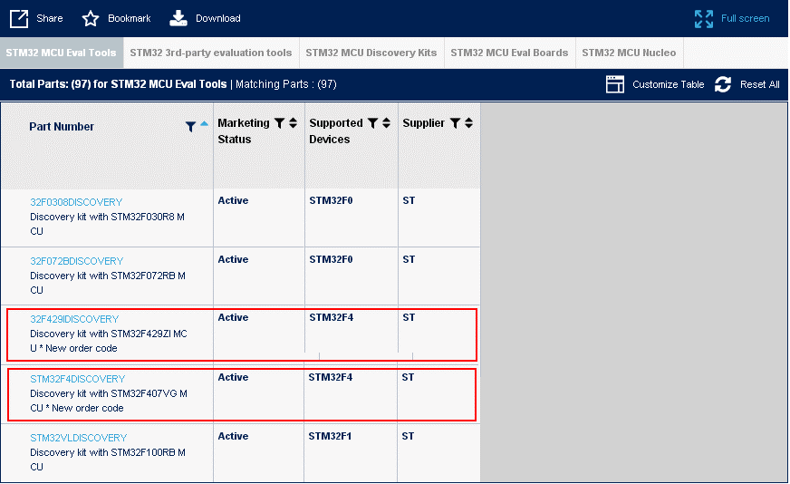
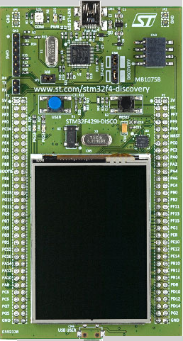
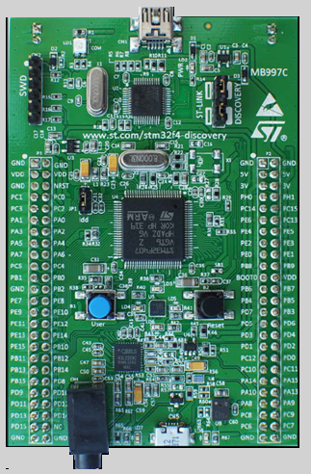
STM32 MCU Discovery Kits

Slide 4
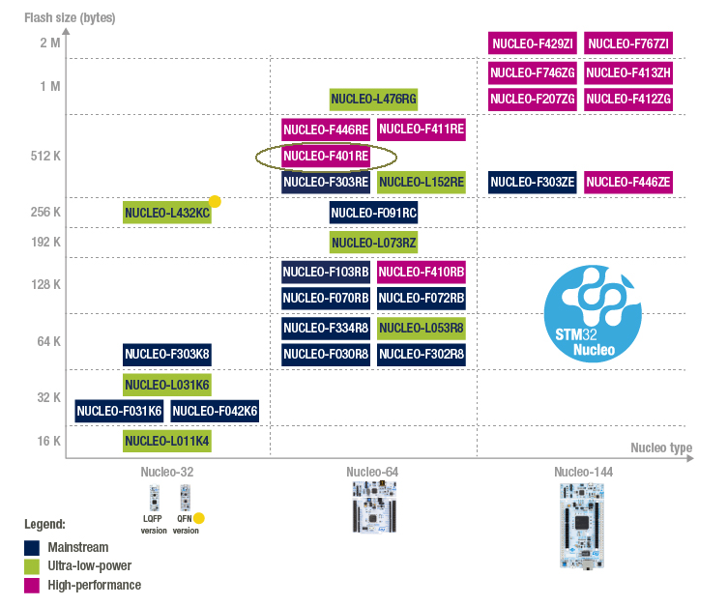
STM32 Nucleo boards
STM32 Nucleo ecosystem
scalable, small-form-factor variants
Tiny 32 Pins MCU
64 Pins MCU
144 Pins MCU

Slide 5
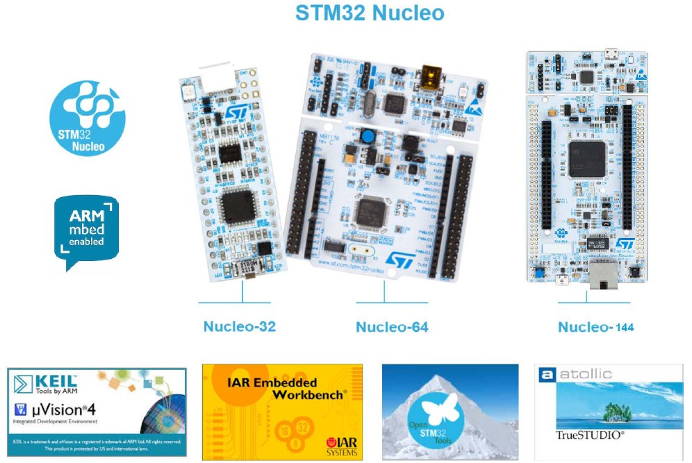
STM32 Nucleo ecosystem

Slide 6
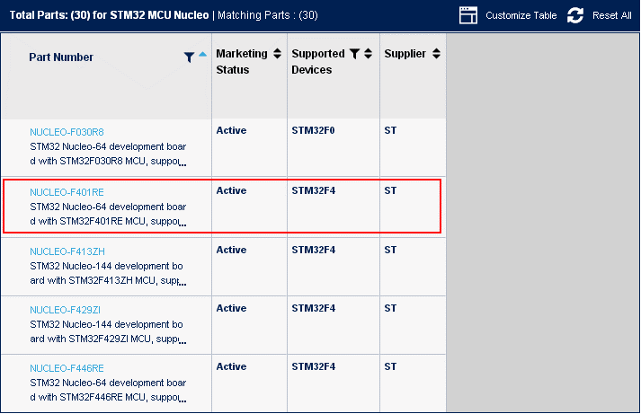
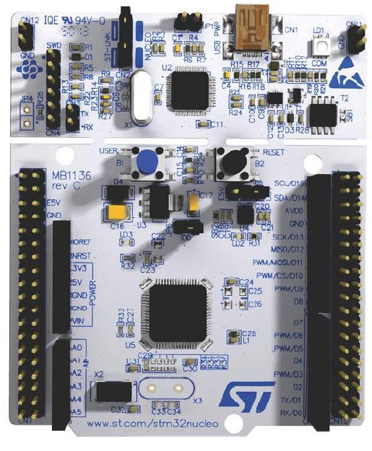

STM32 Nucleo-64 development board with STM32F401RE MCU, supports Arduino and ST morpho connectivity
Key Features:
STM32 microcontroller in QFP64 package
Two types of extension resources: Arduino™ Uno V3 connectivity ST morpho extension pin headers for full access to all STM32 I/Os
ARM® mbed™ (see http://mbed.org )
On-board ST-LINK/V2-1 debugger/programmer with SWD connector:
Selection-mode switch to use the kit as a standalone ST-LINK/V2-1
Flexible board power supply: USB VBUS or external source(3.3V, 5V, 7 - 12V)
Power management access point
Three LEDs: USB communication (LD1), user LED (LD2), power LED (LD3)
Two push-buttons: USER and RESET
USB re-enumeration capability. Three different interfaces supported on USB: Virtual COM port /Mass storage/Debug port
Support of wide choice of Integrated Development Environments (IDEs) including IAR™,ARM® Keil®, GCC-based IDEs
ST-LINK/V2-1
SWD connector
Arduino connetct
ST morpho connetct

Slide 7
STM32F4-DISCOVERY
Побудовано на STM32F407VGT6 мікроконтролері і містить
an ST-LINK/V2 embedded debug too (програматор-відладчик)
ST MEMS digital accelerometer (акселерометр)
ST MEMS digital microphone (мікрофон)
audio DAC with integrated class D speaker driver
LEDs, pushbuttons and a USB OTG micro-AB connector

Slide 8
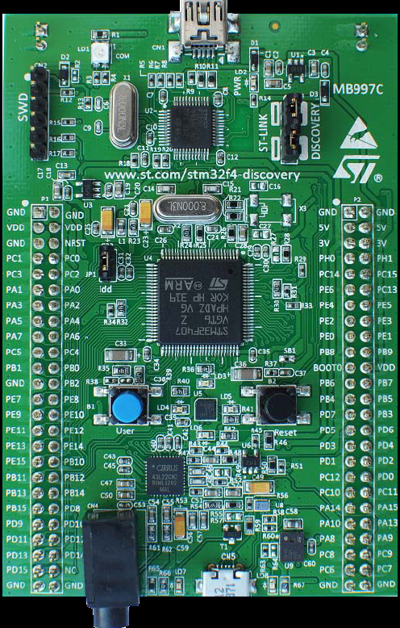
CN1(USB connector)
LD1 (red|green LED) COM
LD2 (red LED) PWR
Програматор–відладчик ST-LINK/V2
CN3 (ST-LINK Discovery)
CN2 SWD connector
УВАГА! Перевірте ці перемикачі
I/O pins Port PA,PB,PC,PD
JP1 xON
I/O pins Port PA,PB,PC,PD
MCU STMF407VG
LD3 (orange LED)
B1 User button
B2 Reset button
LD4 (green LED)
LD5 (red LED)
LD6 (blue LED)
Audio DAC with integrated class D speaker driver
(green LED) LD7
LD8 (red LED)
CN5(USB connector)

Slide 9
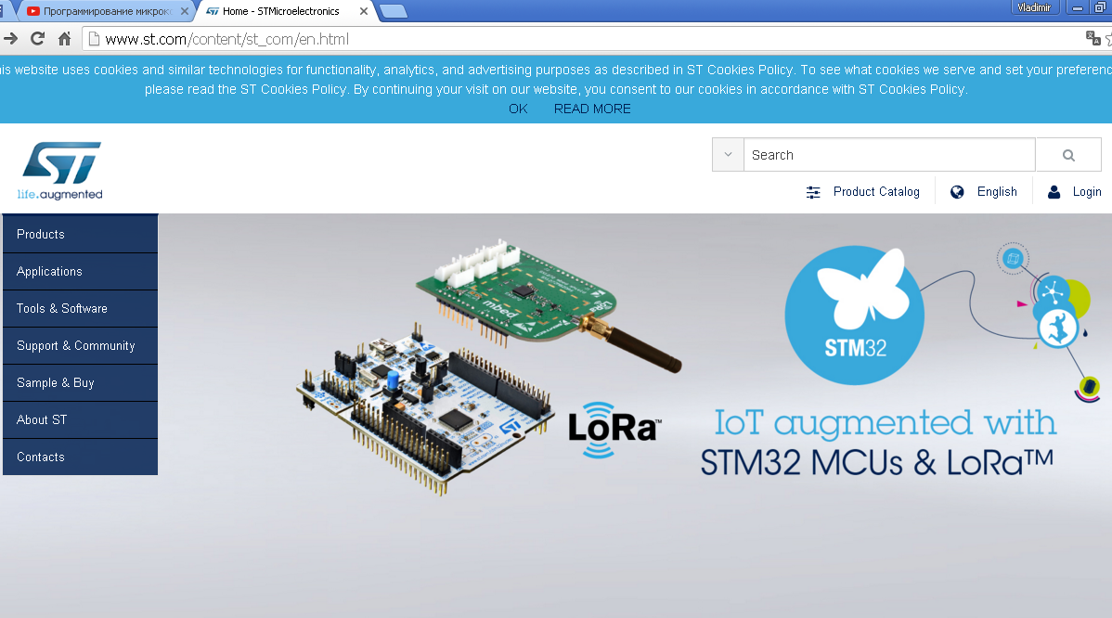
Офіційний сайт STMicroelectronics www.st.com

Slide 10
Product Catalog

Slide 11
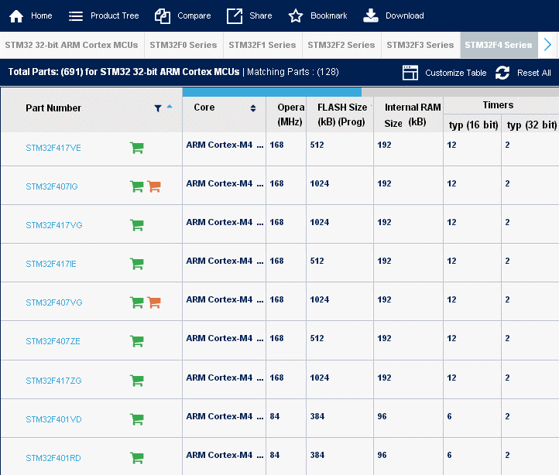

Slide 12
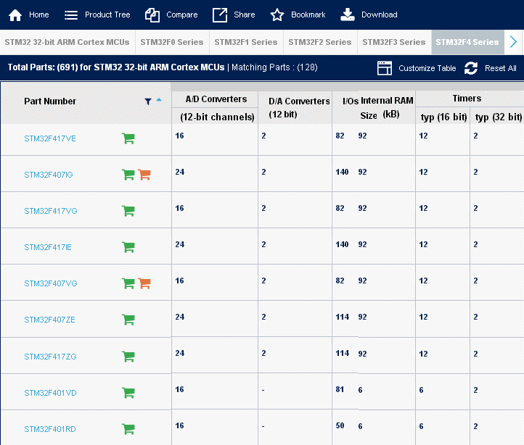

Slide 13
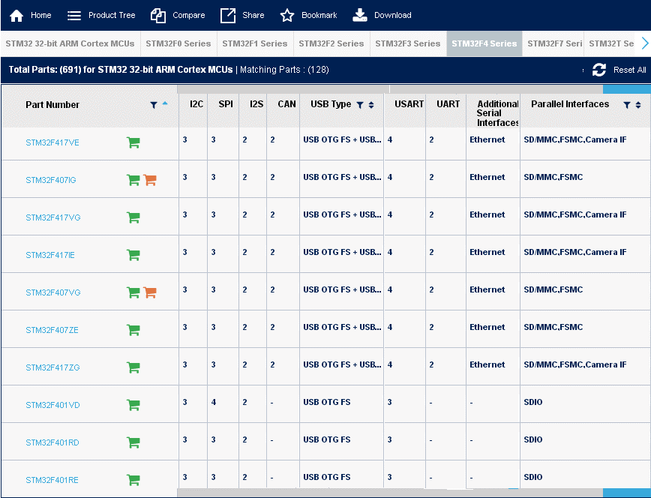

Slide 14
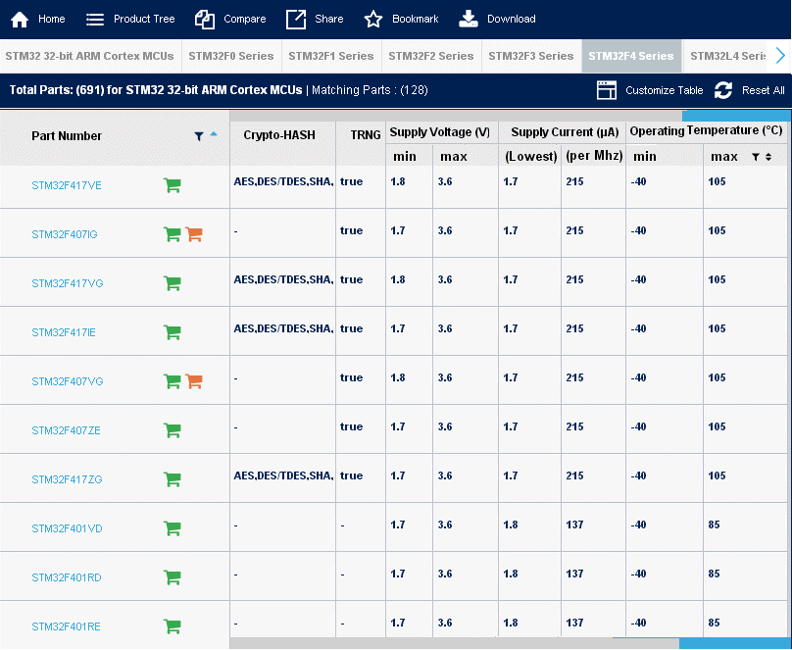

Slide 15
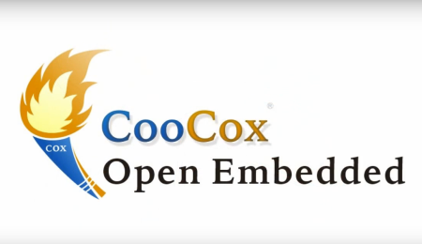
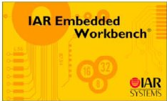

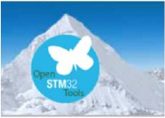
SOFTWARE DEVELOPMENT TOOLS (Development toolchain )
Засоби розробки програмного забезпечення
Part Number | Manufacturer | Descryption
CoIDE | CooCox | CooCox CoIDE®, a free and highly-integrated software development environment for ARM Cortex MCUs
DS-5 | ARM | ARM Development Studio 5 (DS-5) provides best-in-class tools for the broadest range of ARM processor-based platforms
IAR-EWARM | IAR | IAR Embedded Workbench® - Integrated development environment and optimizing C/C++ compiler for ARM Cortex-M
MDK-ARM-STM32 | Keil™ | MDK-ARM software development environment for Cortex-M based MCUs
STM32CubeMX | ST | STM32Cube - initialization code generator
FLASHER-STM32 | ST | STM32 Flash loader demonstrator (UM0462)
CooCox CoIDE ®- вільно розповсюджуване і інтегроване середо-вище розробки програмного забезпечення для ARM Cortex MCUs
ARM Development Studio 5 (DS-5) забезпечує кращі в своєму класі інструменти для широкого кола платформ
на базі ARM-процесорів
IAR Embedded Workbench® - інтегроване середовище розробки та оптимізований C / C ++ компілятор для ARM Cortex-M
MDK-ARM середовище розробки програмного забезпечення для мікроконтролерів на основі Cortex-M
STM32Cube® - генератор коду ініціалізації
STM32 Flash- навантажувач демонстратор (UM0462)

Slide 16
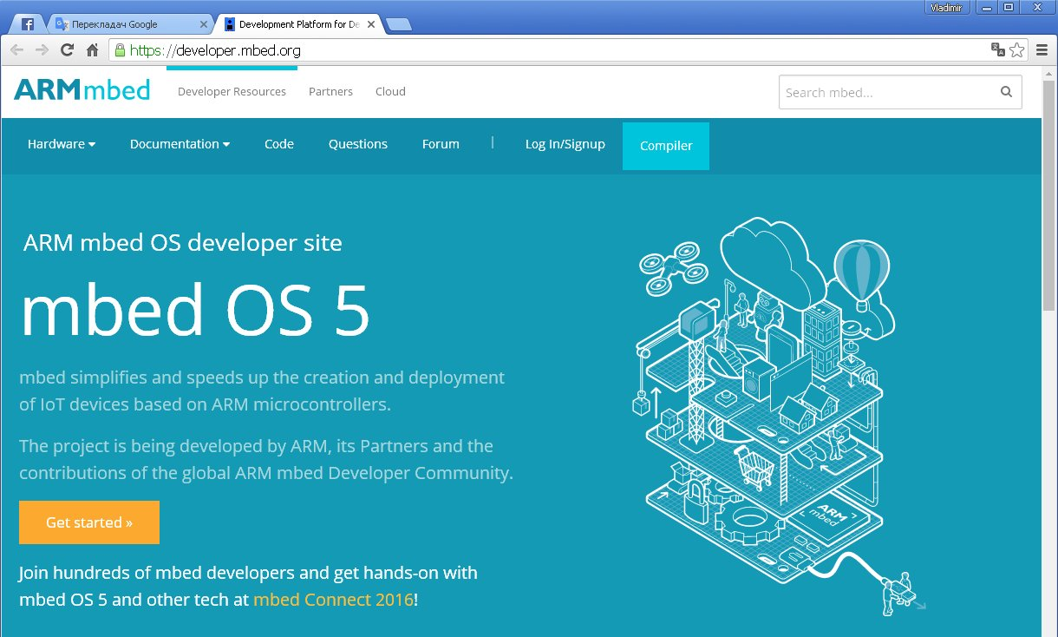
mbed Online development & community

Slide 17
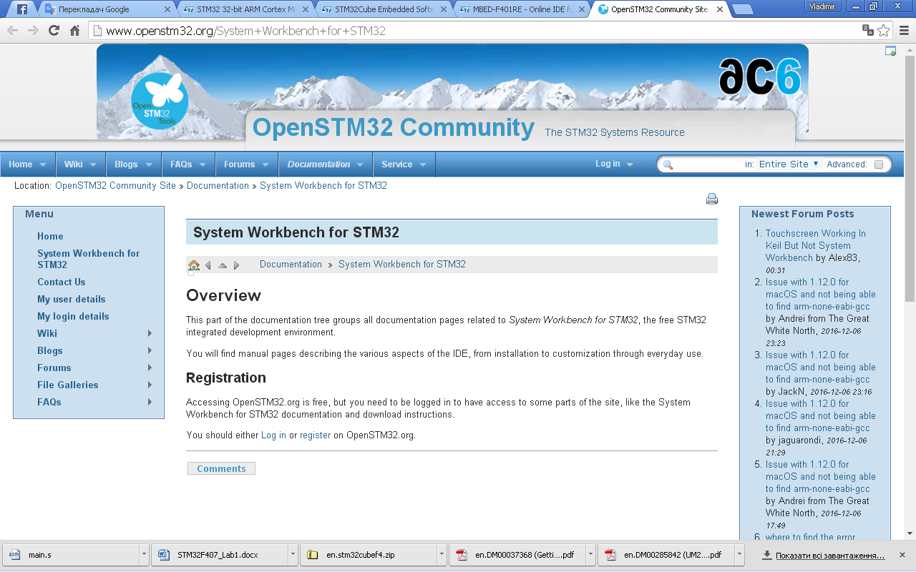
dC6 - Eclipse-based toolset SW4STM32

Slide 18
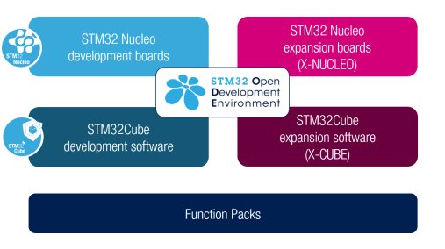
STM32 Open Development Environment
http://www.st.com/en/evaluation-tools/stm32-mcu-nucleo.html?querycriteria=productId=LN1847
http://www.st.com/content/st_com/en/products/ecosystems/stm32-open-development-environment/stm32-nucleo-expansion-boards.html?querycriteria=productId=SC2006
http://www.st.com/content/st_com/en/products/ecosystems/stm32-open-development-environment/stm32-ode-function-packs.html?querycriteria=productId=SC2102
http://www.st.com/content/st_com/en/products/ecosystems/stm32-open-development-environment/stm32cube.html?querycriteria=productId=SC2004
http://www.st.com/content/st_com/en/products/ecosystems/stm32-open-development-environment/stm32cube-expansion-software.html?querycriteria=productId=SC2005

Slide 19
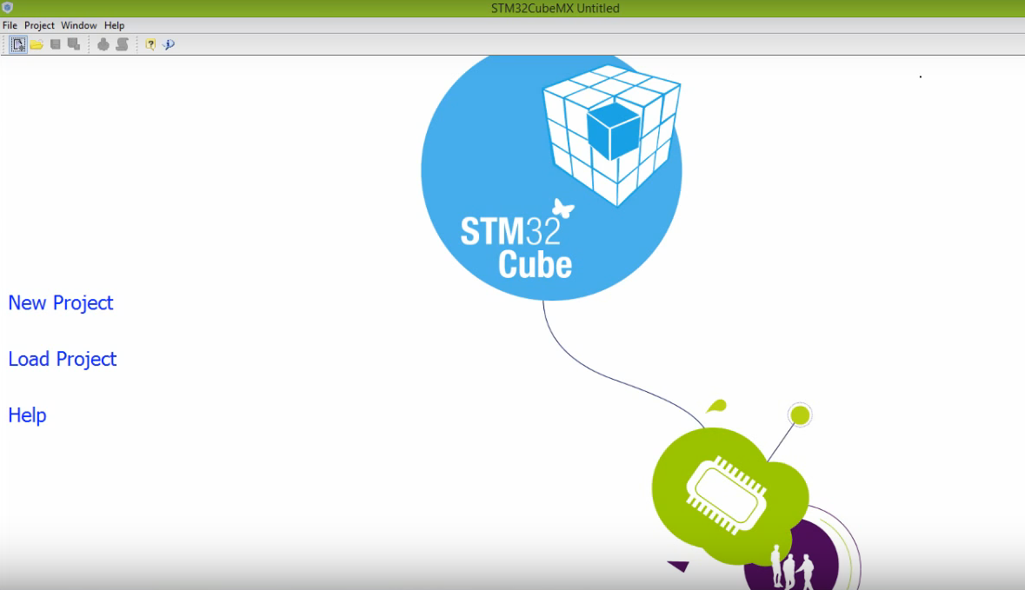
STM32Cube software
1. STM32Cube initialization code generator
3. STM32Cube expansion software
2. STM32CubeMX

Slide 20
Литература
1. Cortex M3 Technical Reference Manual Режим доступа: http://infocenter.arm.com/help/topic/com. arm.doc.ddi0337g/index.html
2. Cortex M4 Technical Reference Manual Режим доступа: http://infocenter.arm.com/help/topic/com.arm.doc.100166_0001_00_en/arm_cortexm4_processor_trm_100166_0001_00_en.pdf (DDI0439B_cortex_m4_r0p0_trm.pdf – файл на Goodle-Disk)
3. ARMv7-M Architecture Application Level Reference Manual Режим доступа: www.arm.com/products/CPUs/ARM_Cortex-М3_v7.html
Related documents Available from STMicroelectronics web site (http://www.st.com ):
• STM32F40x and STM32F41x datasheets
• STM32F42x and STM32F43x datasheets
4. STM32F3xx/F4xxx Cortex®-M4 with FPU programming manual (PM0214) Режим доступа: http://www.alldatasheet.com/datasheet-pdf/pdf/700555 /STMICROELECTRONICS/PM0214.html (en.DM00046982_PM0214.pdf – файл на Goodle-Disk)
5. CoreSight Technology System Design Guide. Режим доступа:
http://infocenter.arm.com/help/topic/com .arm.doc.dgi0012b/index.html
6. АМБА Specification: Режим доступа: www.arm.com/products/solutions/AMBA_Spec.html
7. AAPCS Procedure Саll Standard for the ARM Architecture. Режим доступа:
http://infocenter.аrm.соm/help/topic/com.arm.doc.ihi0042c/index.html
Книги_документация и интернет информация по АРМ_Cortex_STM32.docx

Slide 21
Internet посилання
LINKs http://www.emcu.it/NUCLEOevaBoards/NUCLEOevaBoards.html#LINKs
Stay tuned, find NUCLEO on www.st.com website
Visit the dedicated NUCLEO website.
Getting started with the STM32 Nucleo board firmware packag is here
UM1726 User manual − Getting started with the STM32 Nucleo board firmware package is here

